Slide 1
InfyTech A Complete Tech Store
By
Kaushal Vibhakar - 19012011091

Slide 2
Project Objective
The primary goal of e-commerce is to reach maximum customers at the right time to increase sales and profitability of the business. Functions of e-commerce include buying and selling goods, transmitting funds or data over the internet.

Slide 3
Project Context
Businesses, in any field, have a lot of competition. They are always on the lookout for a proven way to increase their business revenue. Restaurants, retail shops, vape stores - whatever a business may want to sell, if the business doesn’t have an e-commerce website, they are leaving money on the table! The world has moved online – a fact that businesses have to accept and put up a website to address. Through this project, I’ll discover a way to build a functional e-commerce website, relying on React.

Slide 4
Advantages of Ecommerce
Faster buying/selling procedure, as well as easy to find desired products.
24/7 working store.
More reach to the customers.
Low operational costs and better quality of service.
Easy to start and manage a business.

Slide 5
Features
Complete focus on the User Experience
Products Page with Infinite Scroll
Detail model with extra information about the selected items
Various Filters to help choose the desired Products
Add to / Remove from “Cart” functionality
Checkout with Credit Card Option
Customer Sign In & Register
Use of Built In React Hooks as well as Custom Hooks

Slide 6
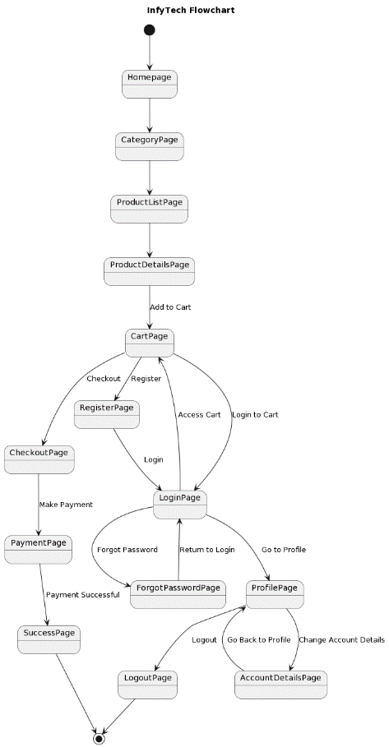
Flowchart

Slide 7
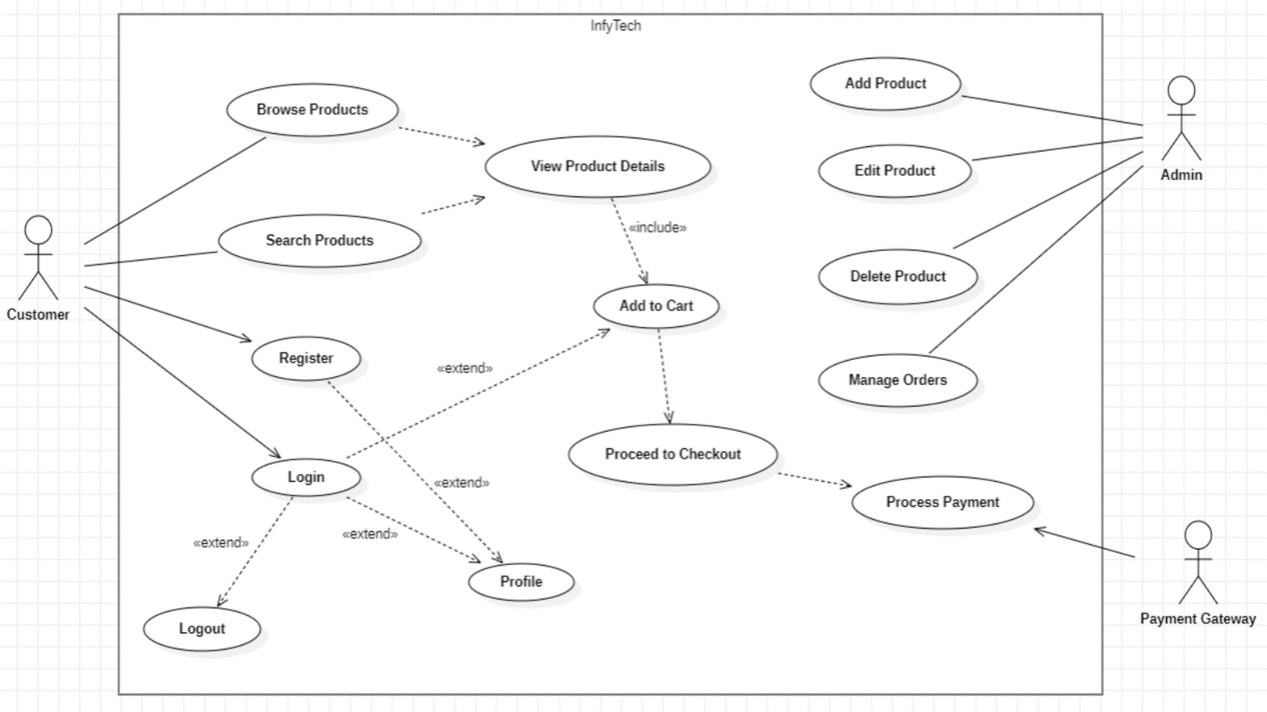
Use Case Diagram

Slide 8
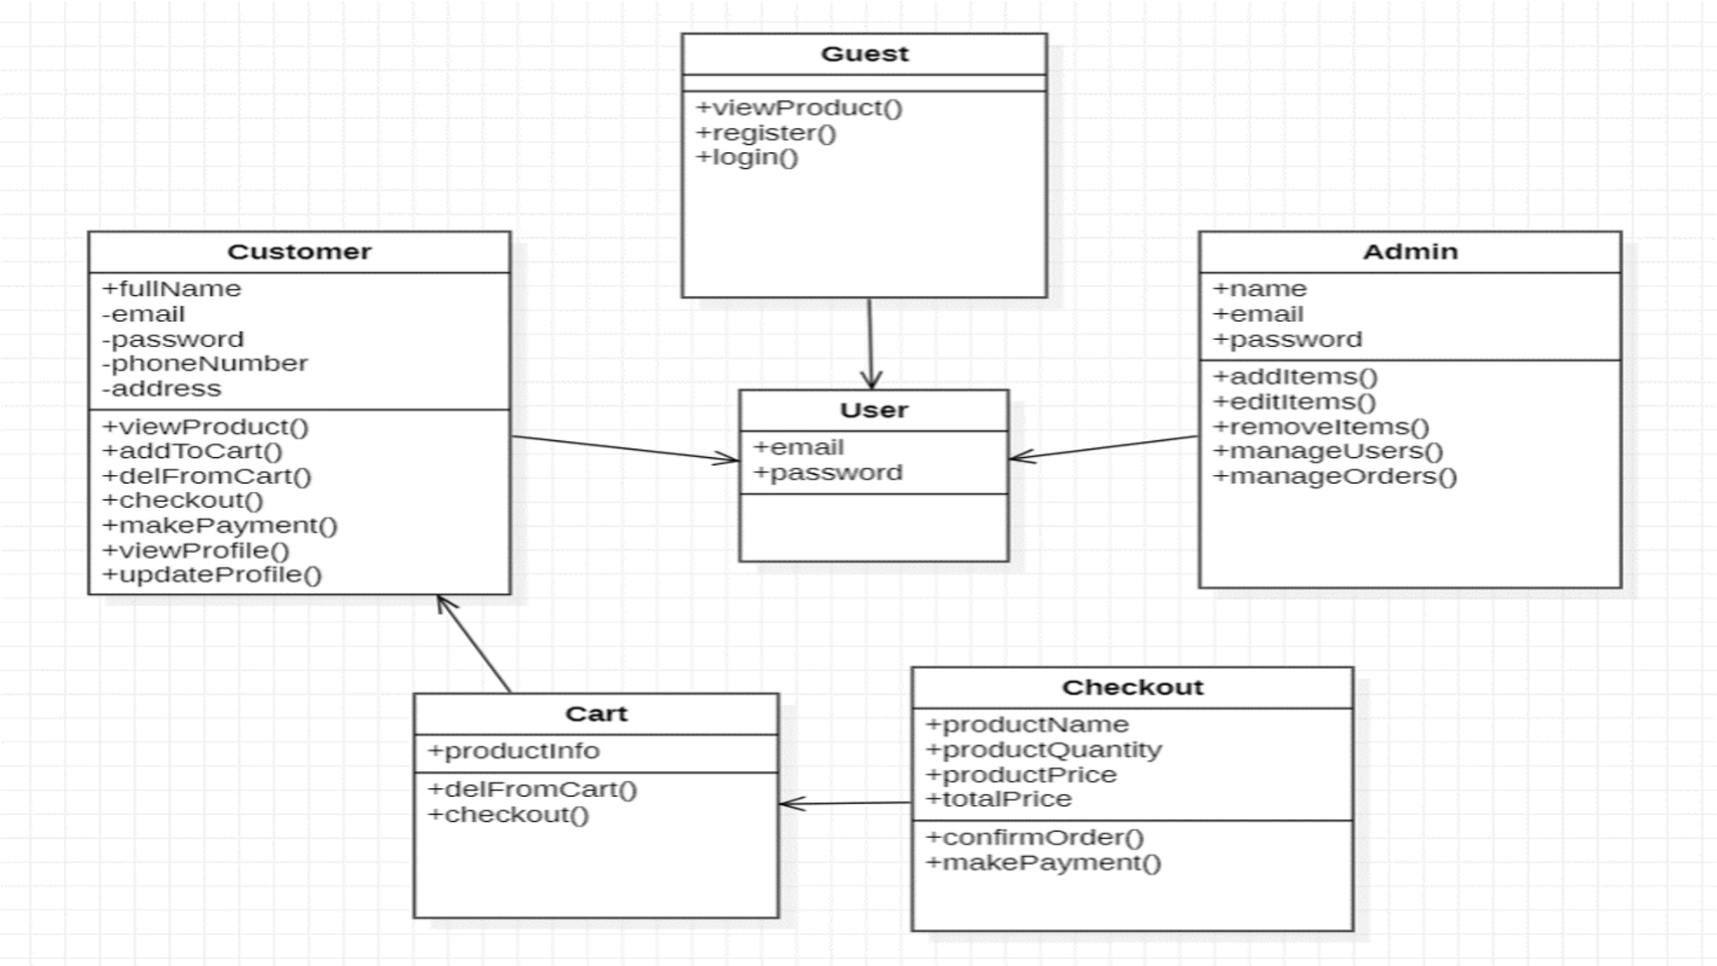
Class Diagram

Slide 9
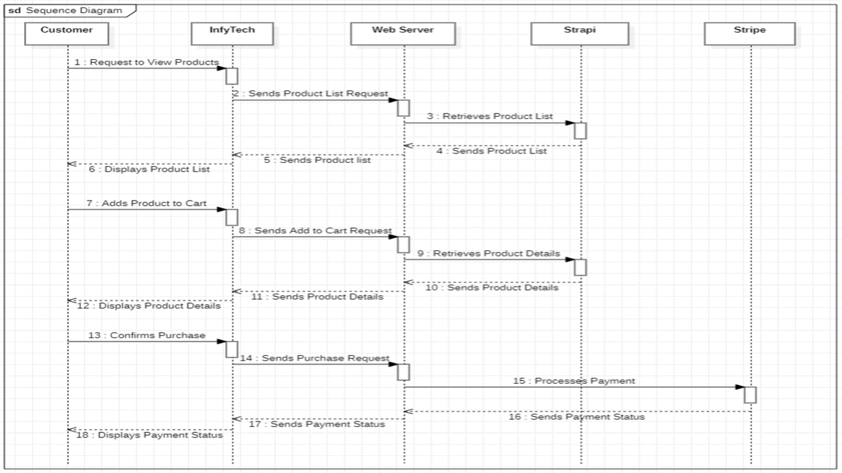
Sequence Diagram

Slide 10
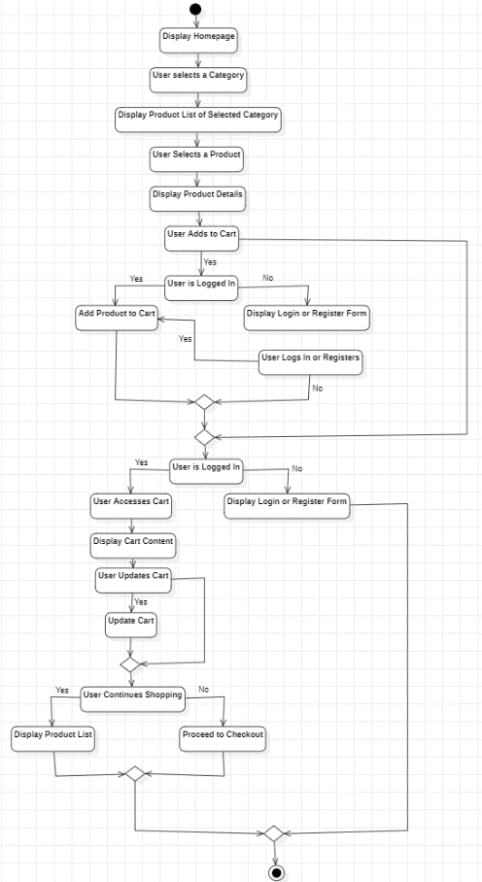
Activity Diagram

Slide 11
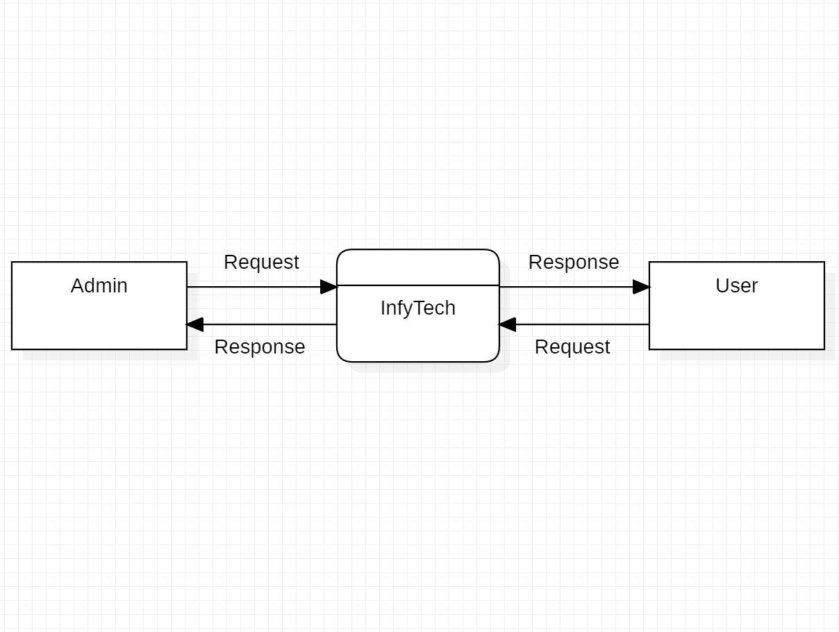
DFD Level 0 Diagram

Slide 12
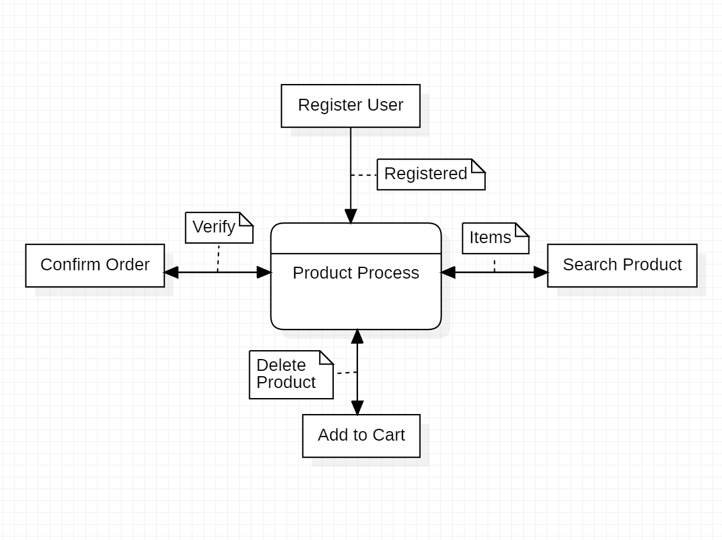
DFD Level 1 Diagram

Slide 13
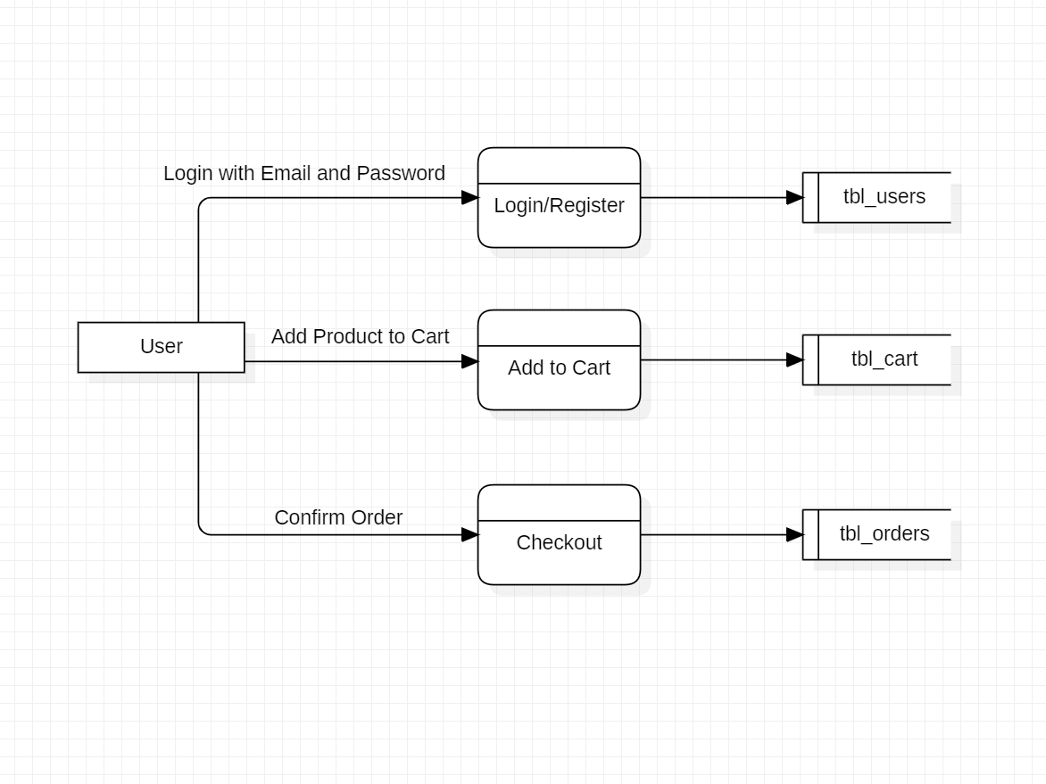
DFD Level 2 Diagram

Slide 14
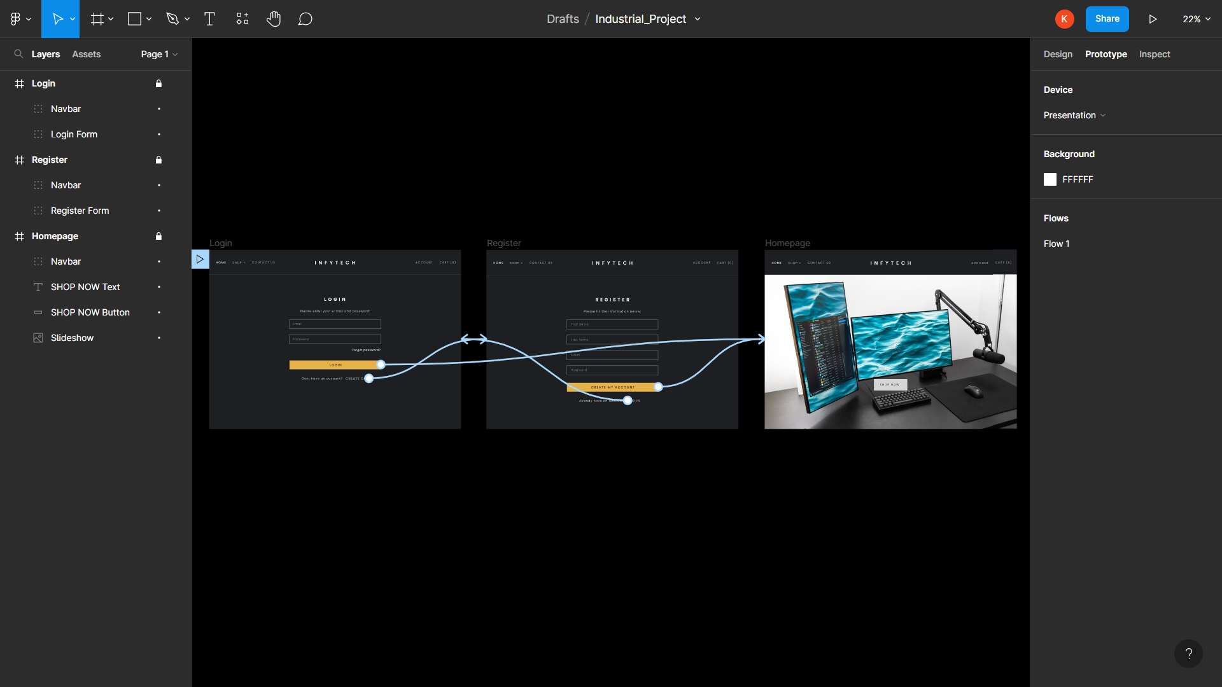
UI Prototype in Figma

Slide 15
Implementation
Programming Languages
Frontend Technology – SCSS, React.js and its Libraries.
Backend Technology – Strapi (A Headless CMS).
Data Sources
SQLite Database
Firebase
Tools
Visual Studio Code

Slide 16
Implementation
Modules in the Web Application
Login, Register and Reset Password Pages
Profile Page
Home Page
Products Page
Cart Component
Checkout Page
About Us and Contact Us Pages
Policy Pages

Slide 17
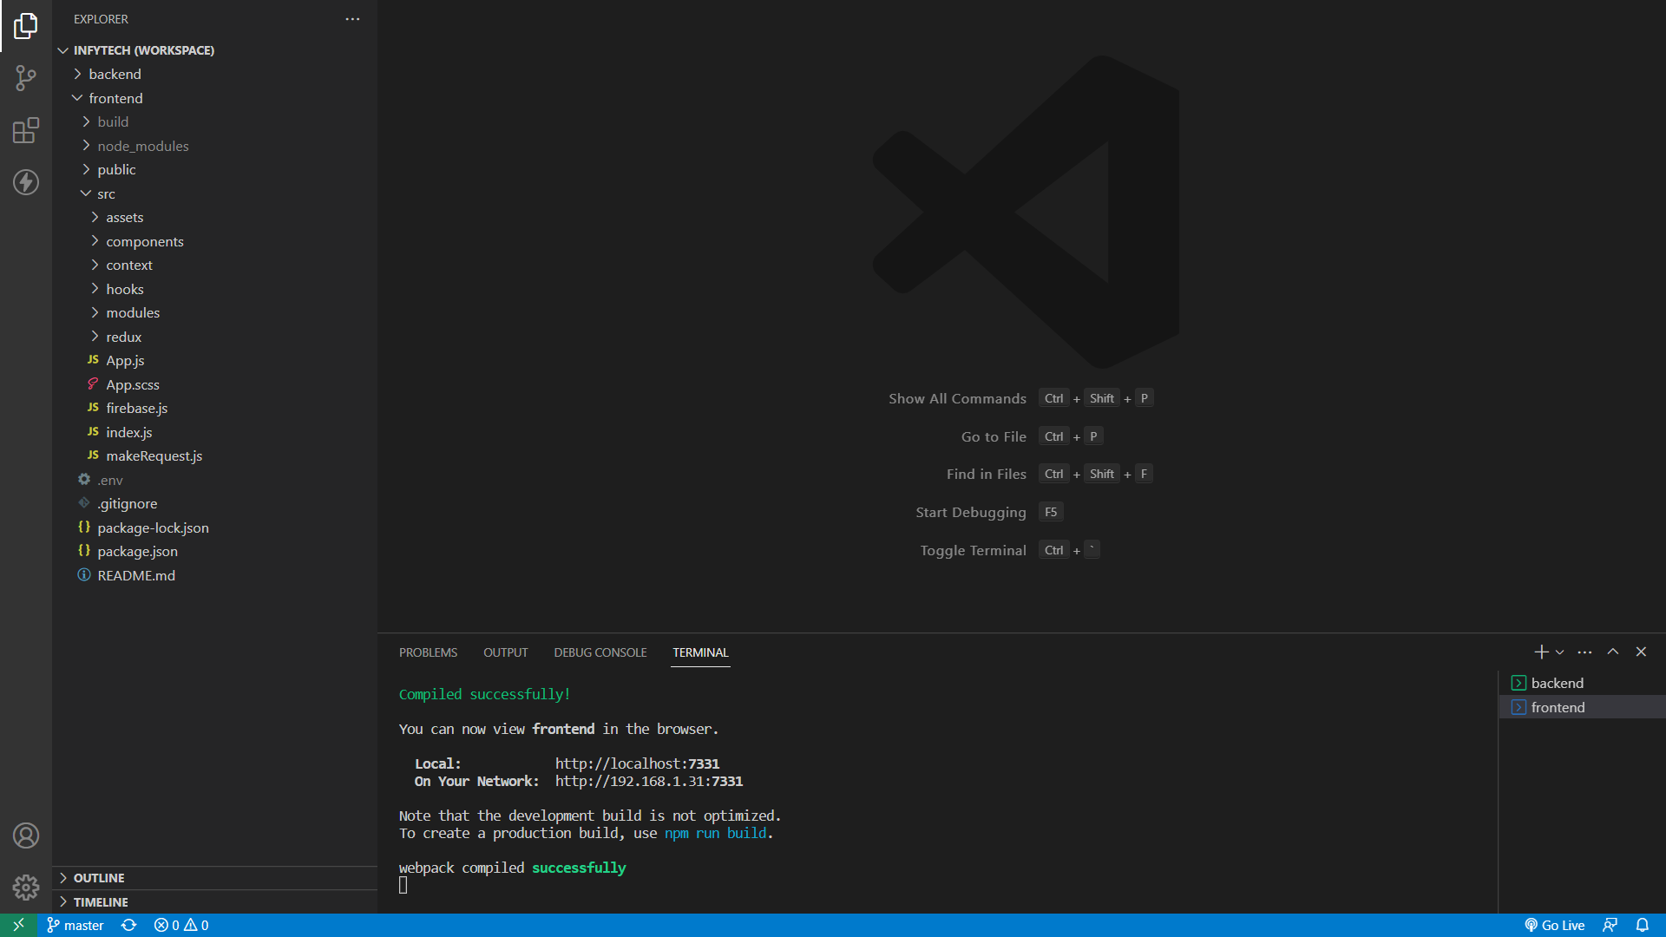
Folder Structure

Slide 18
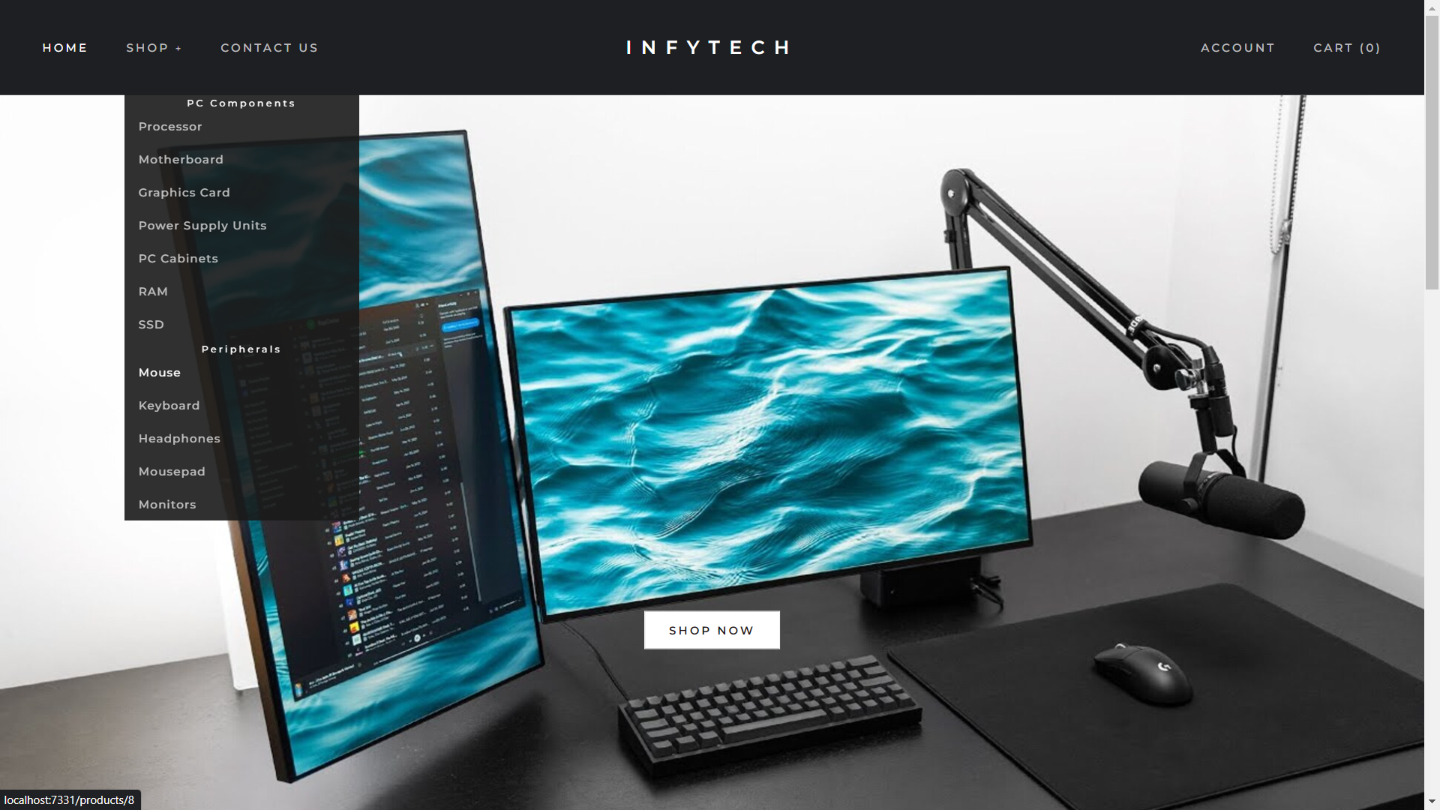
Homepage (1)

Slide 19
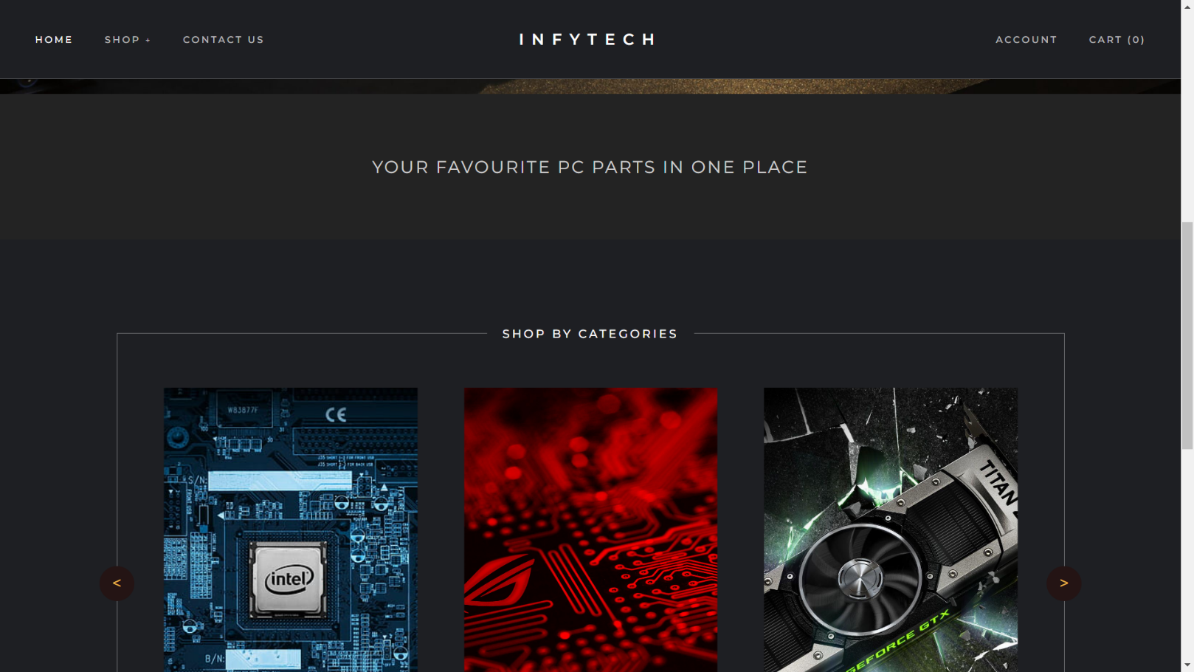
Homepage (2)

Slide 20
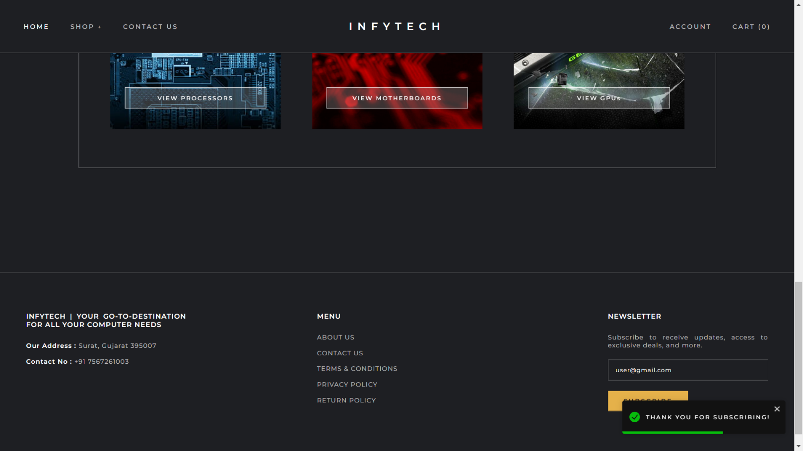
Homepage (3)

Slide 21
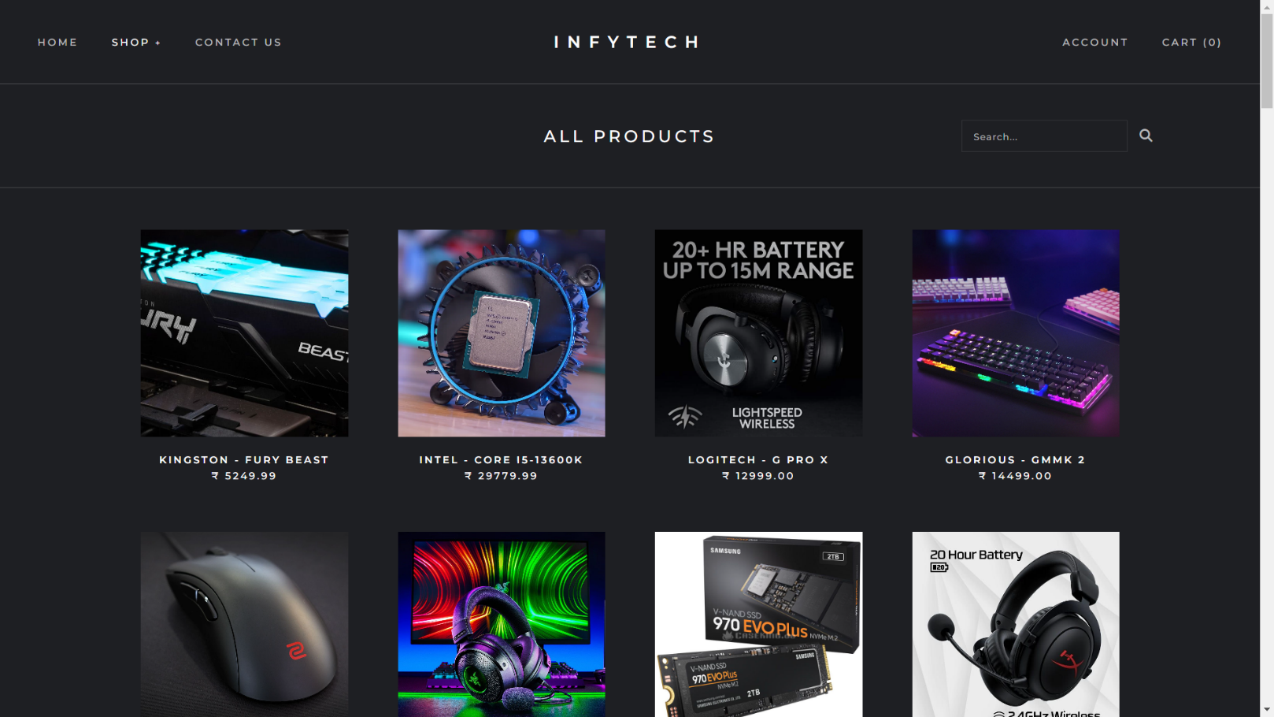
All Products Page

Slide 22
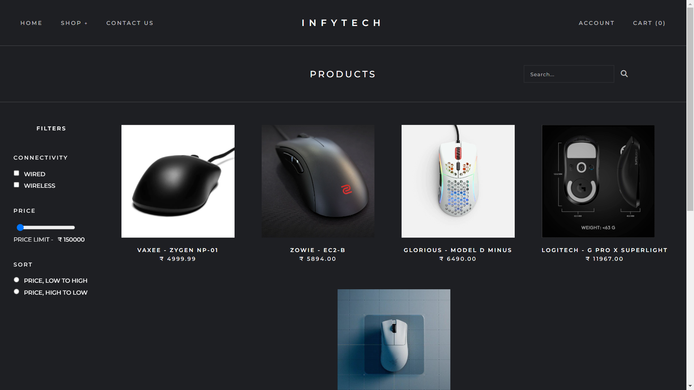
Category Page

Slide 23
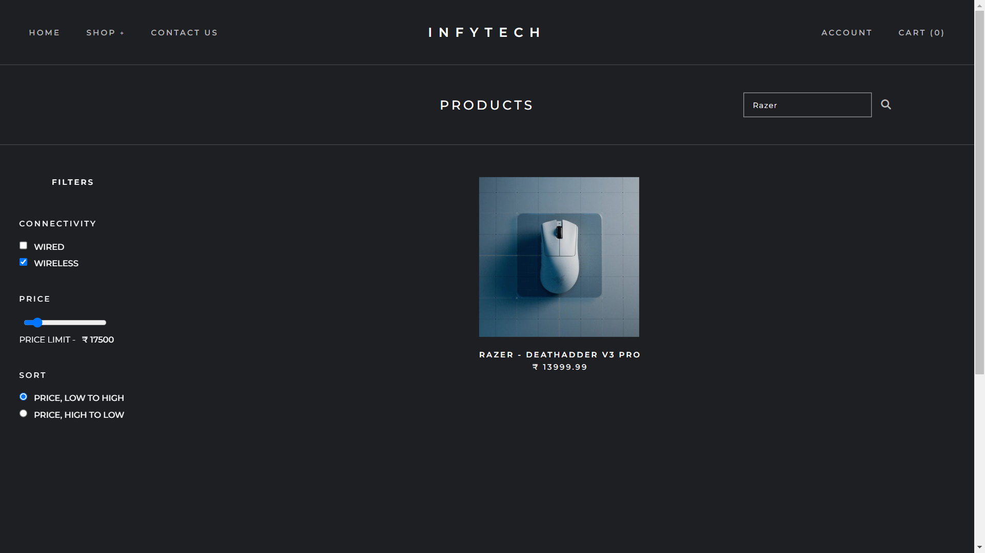
Filtered Category Page

Slide 24
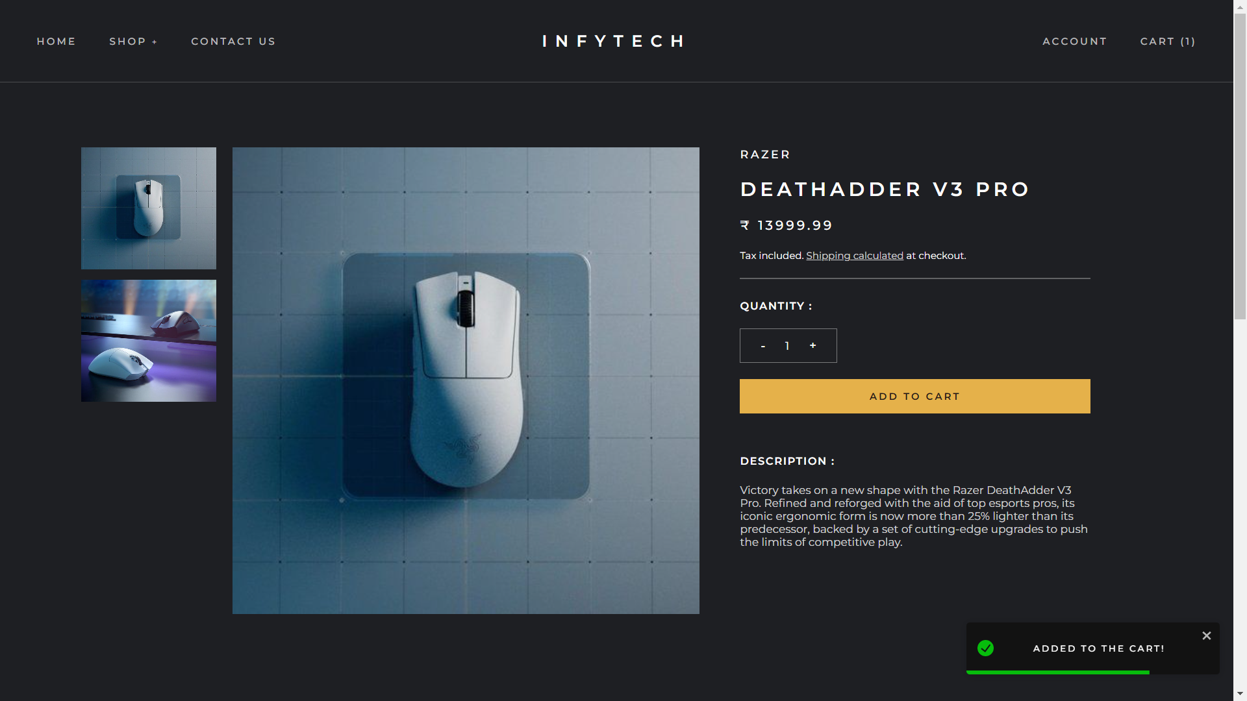
Product Details Page (1)

Slide 25
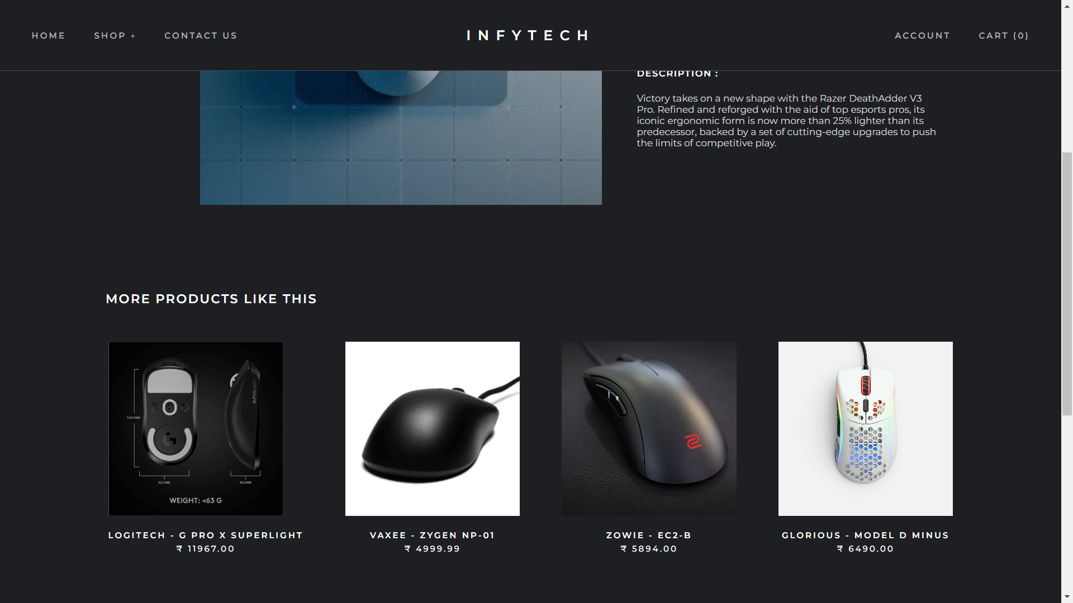
Product Details Page (2)

Slide 26
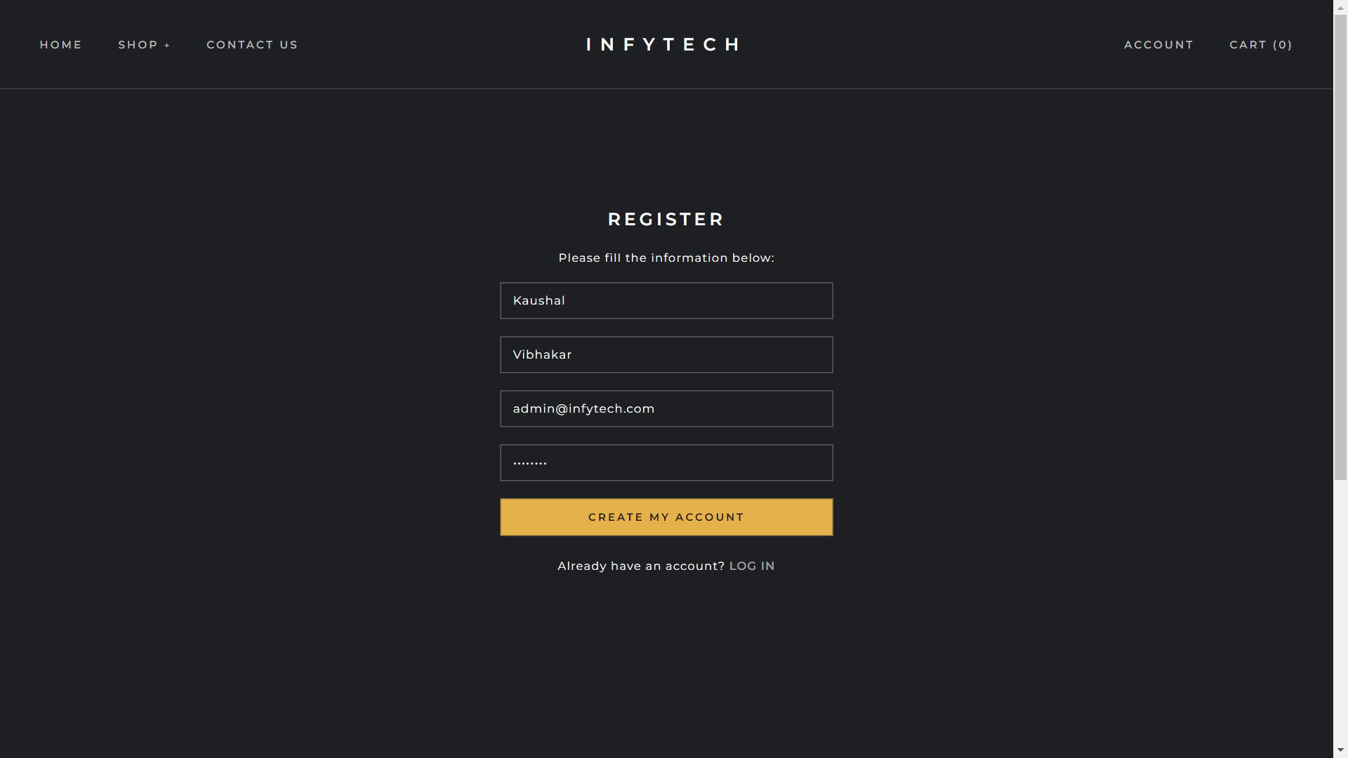
Register Page

Slide 27
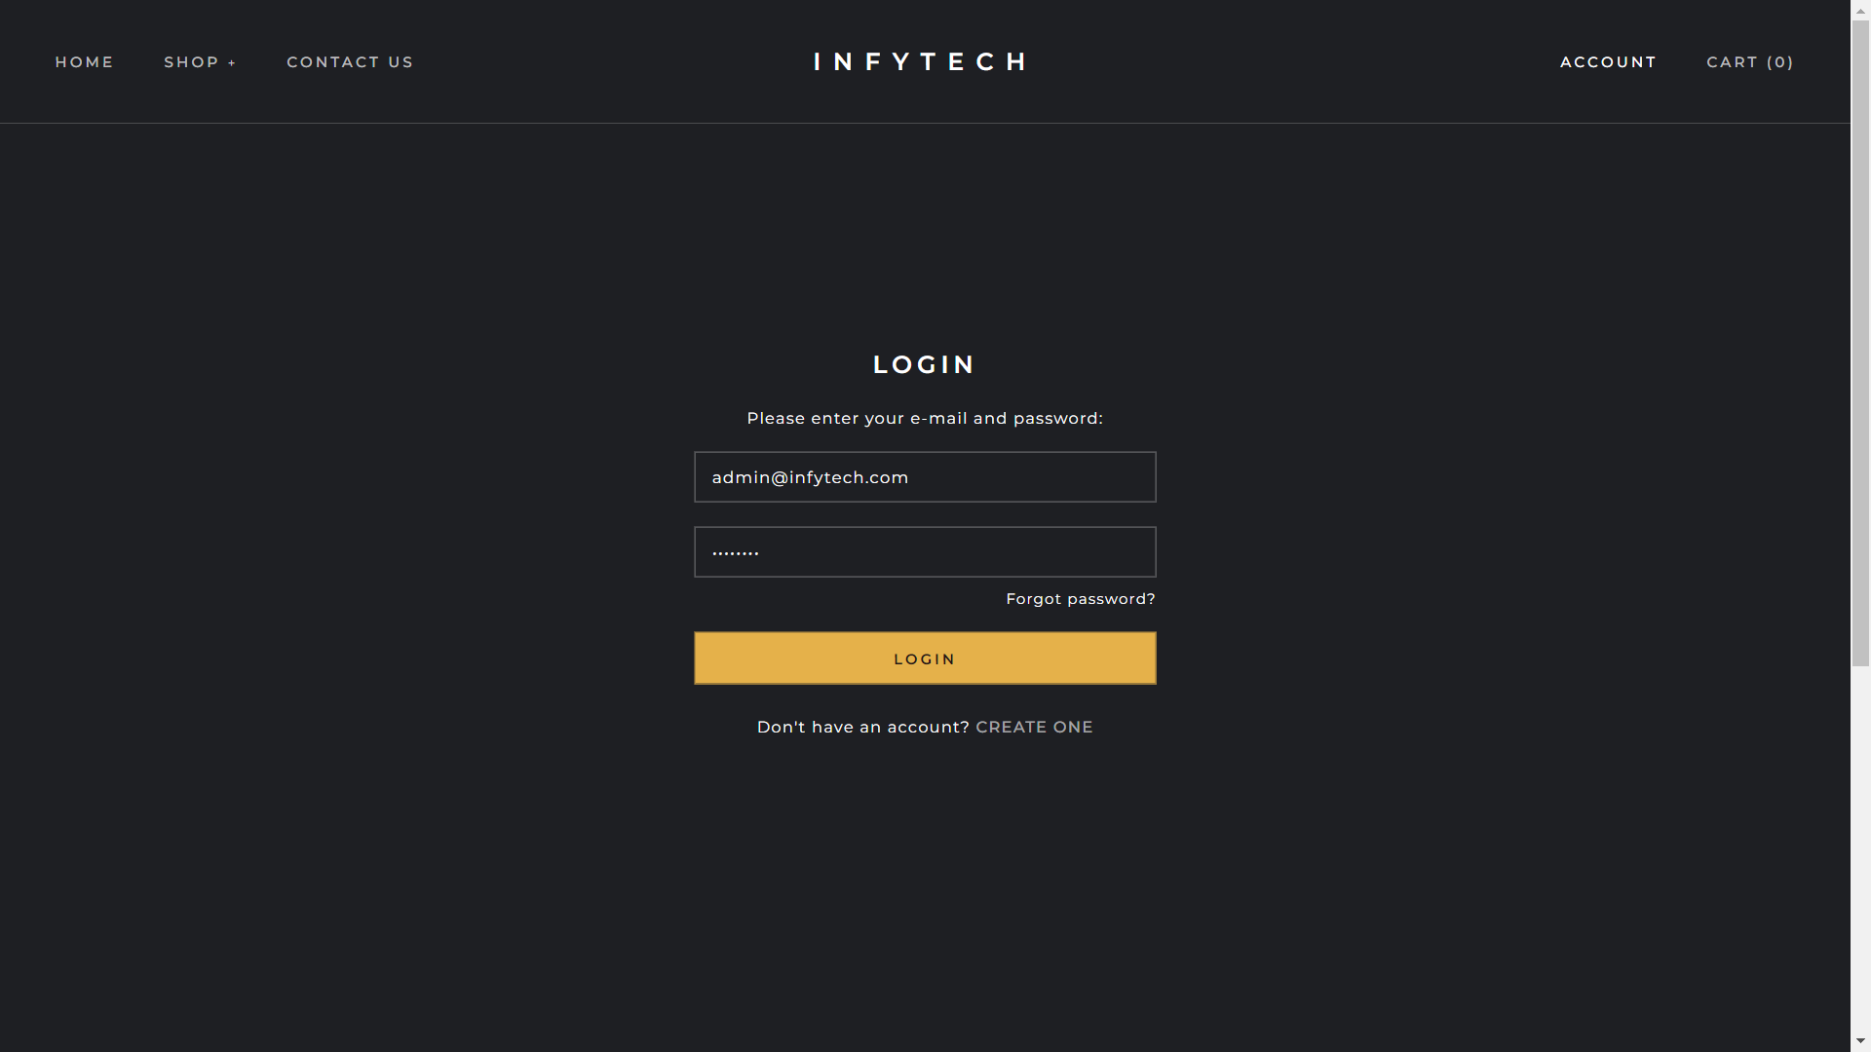
Login Page

Slide 28
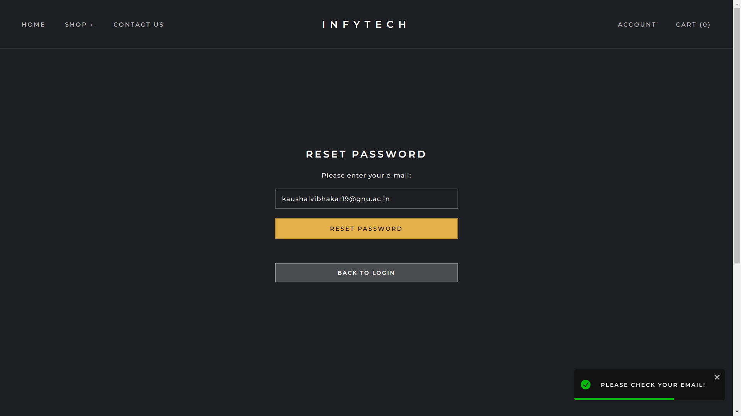
Reset Password Page

Slide 29
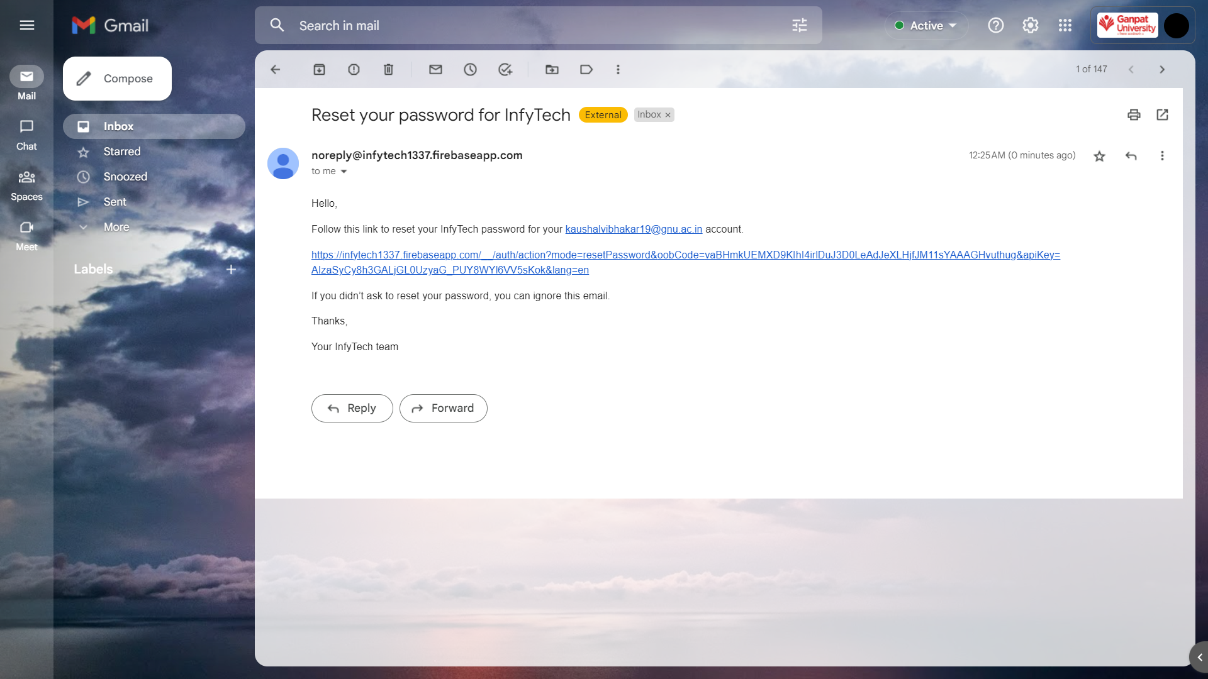
Reset Password Mail

Slide 30
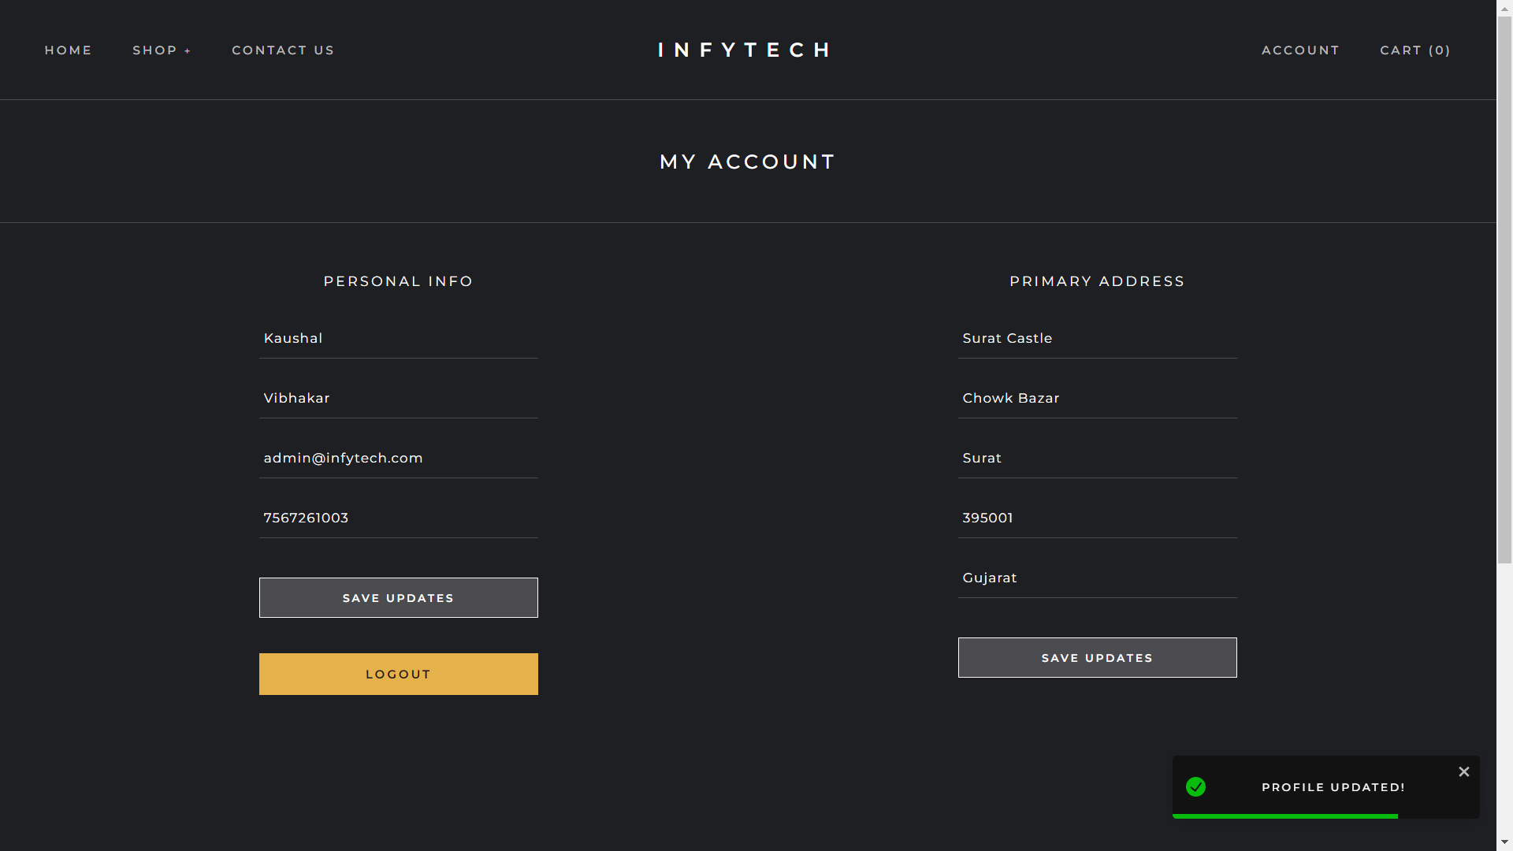
Profile Page

Slide 31
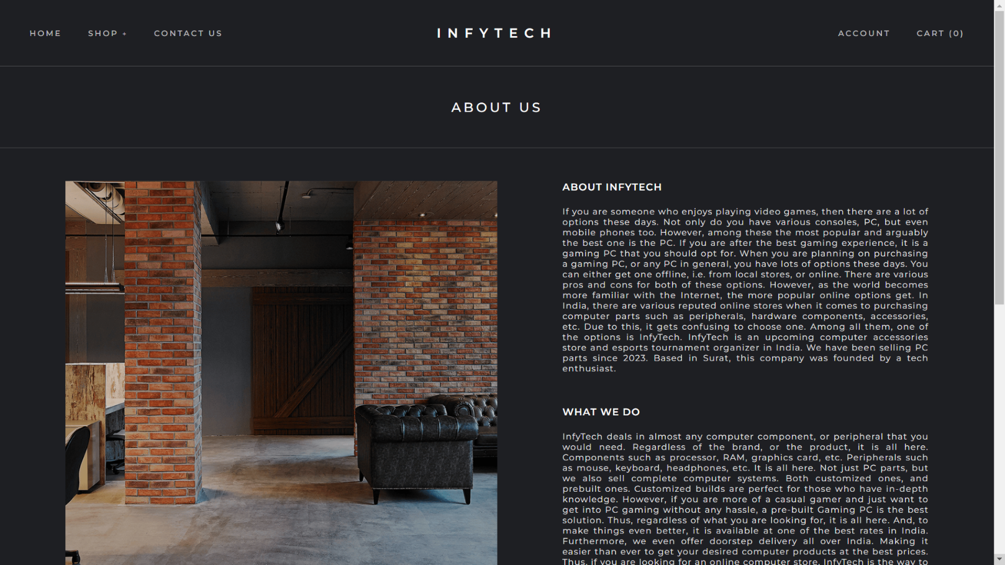
About Us Page

Slide 32
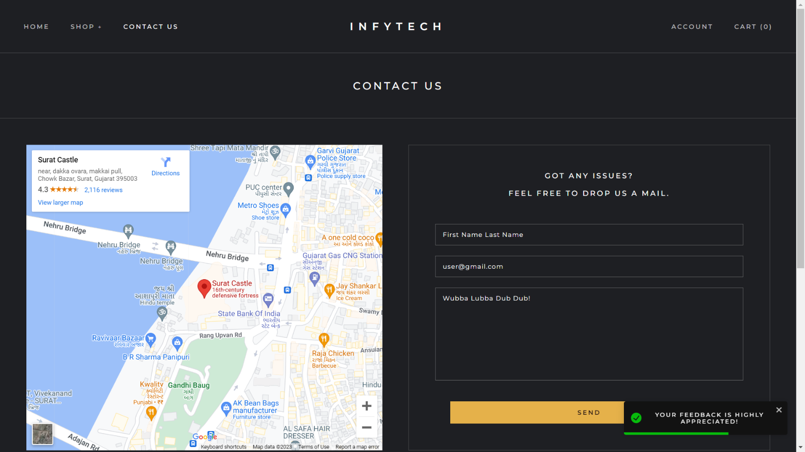
Contact Us Page

Slide 33
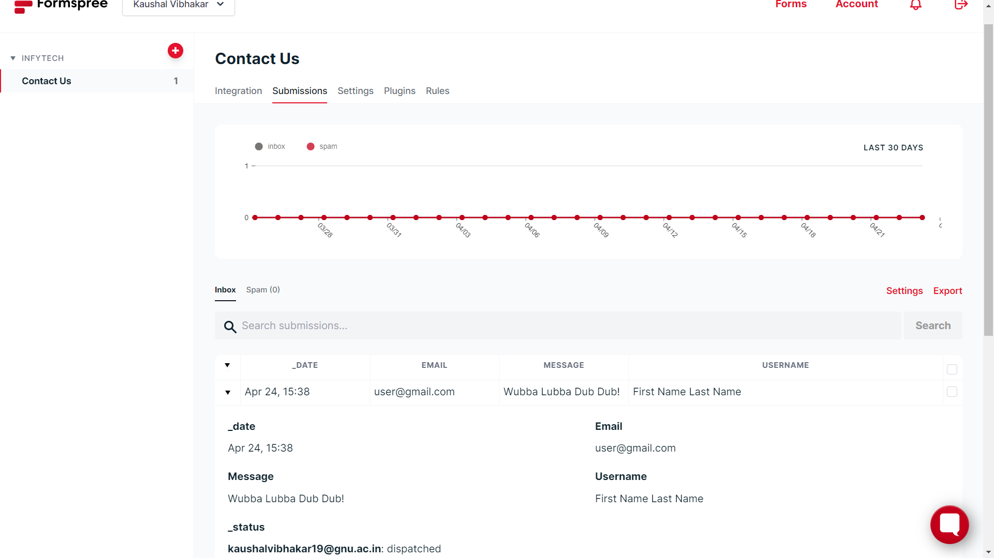
Contact Us Form

Slide 34
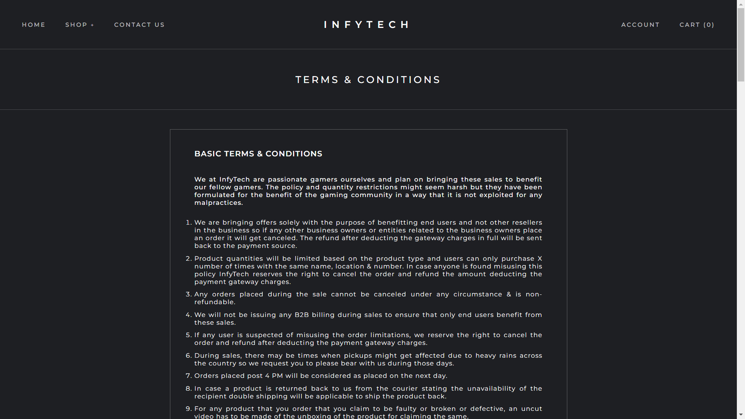
Terms & Conditions Page

Slide 35
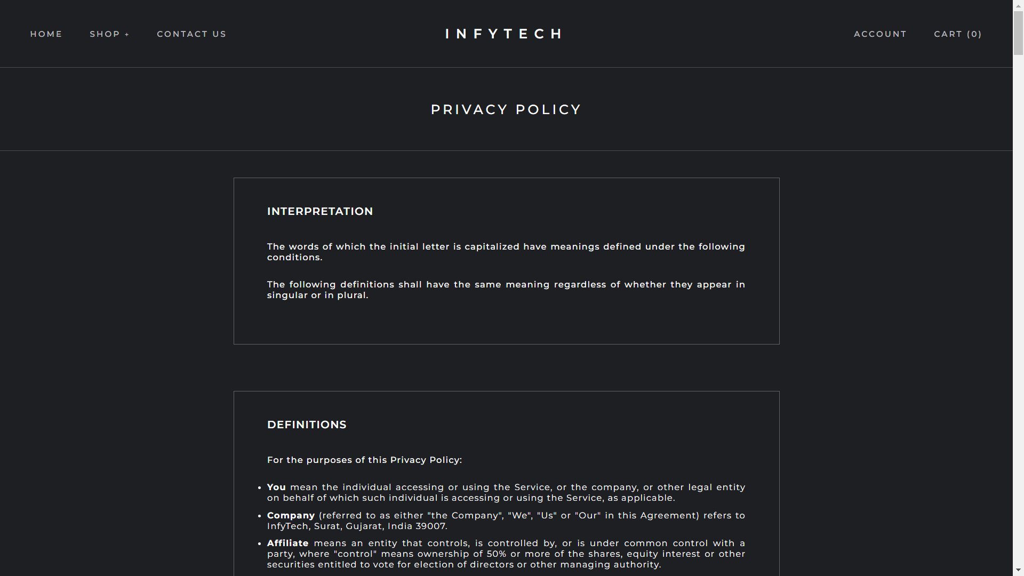
Privacy Policy Page

Slide 36
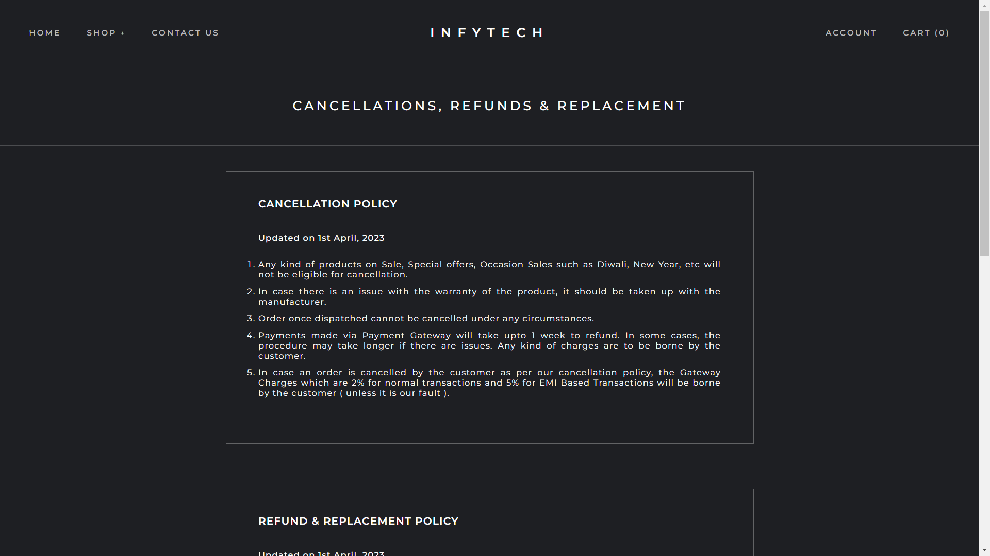
Return Policy Page

Slide 37
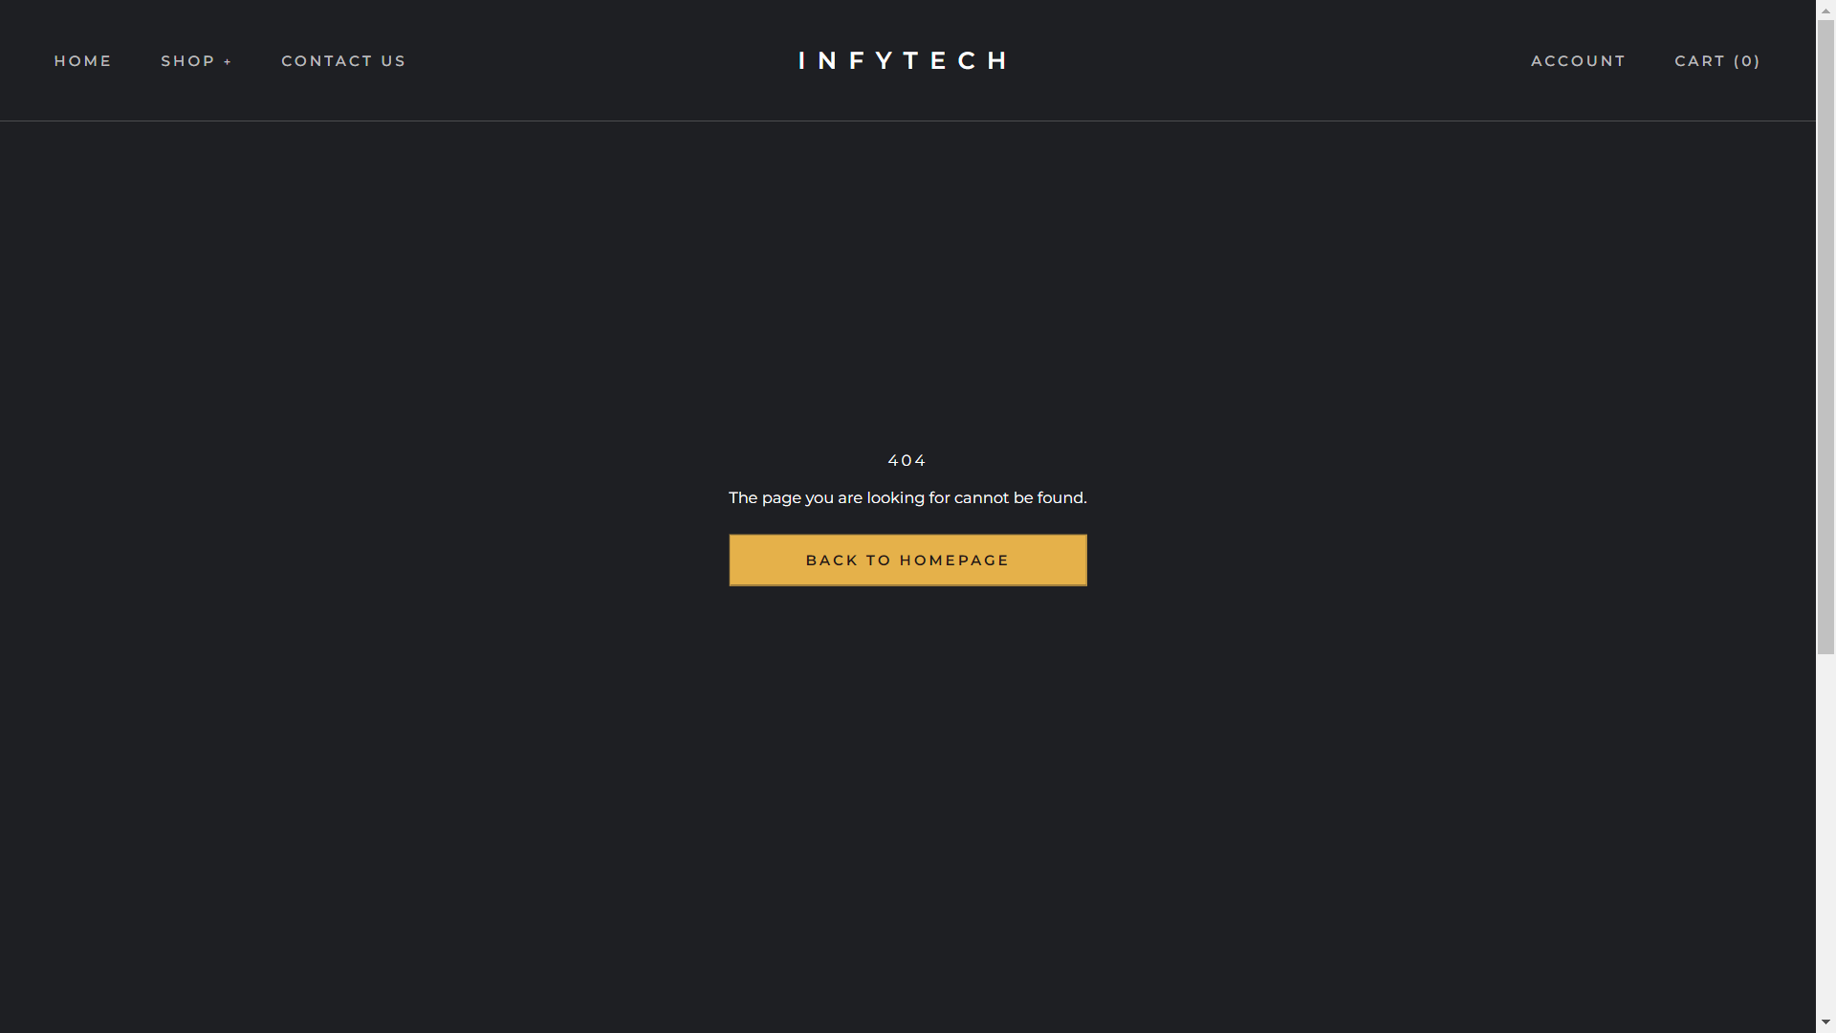
Error Page

Slide 38
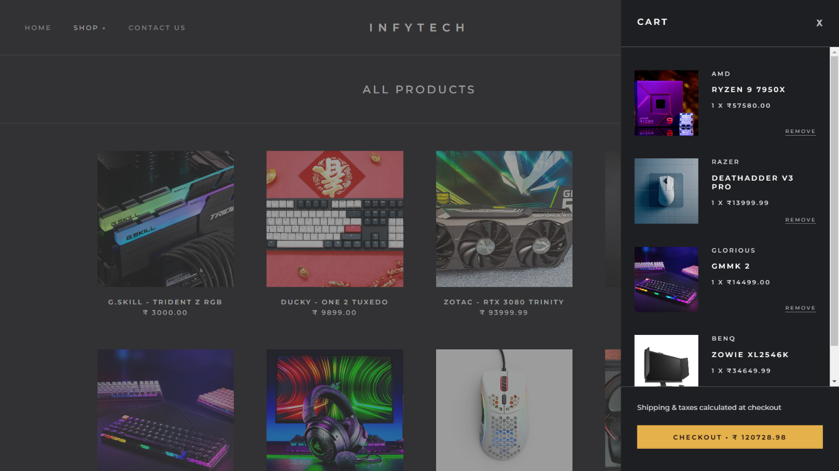
Cart Component

Slide 39
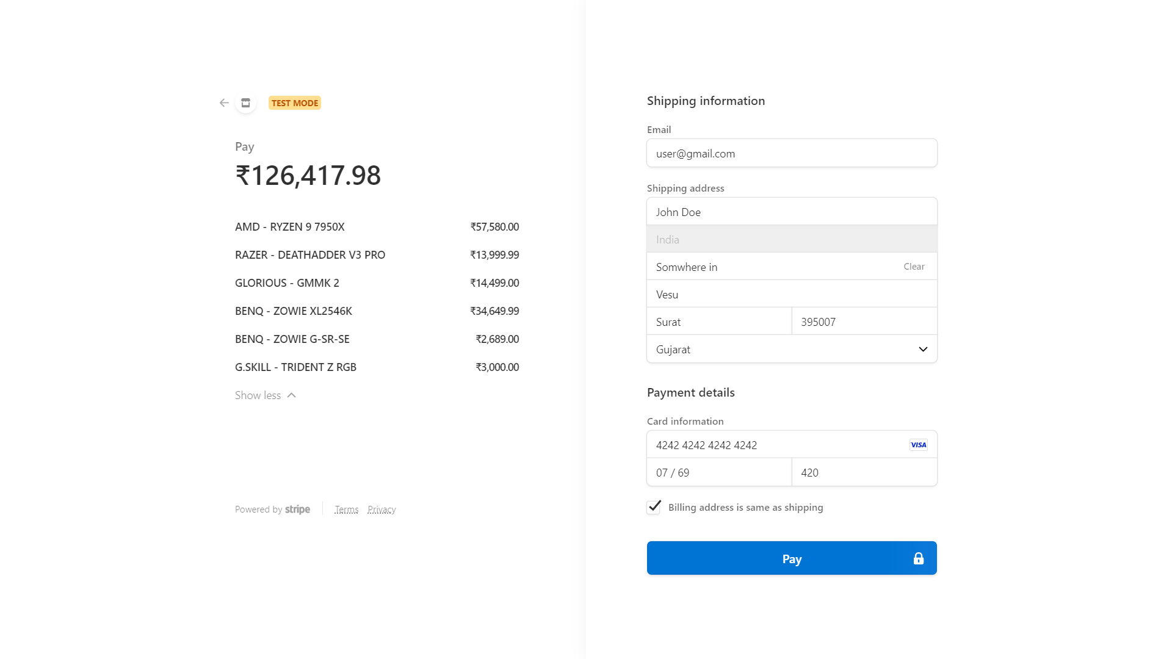
Checkout Page

Slide 40
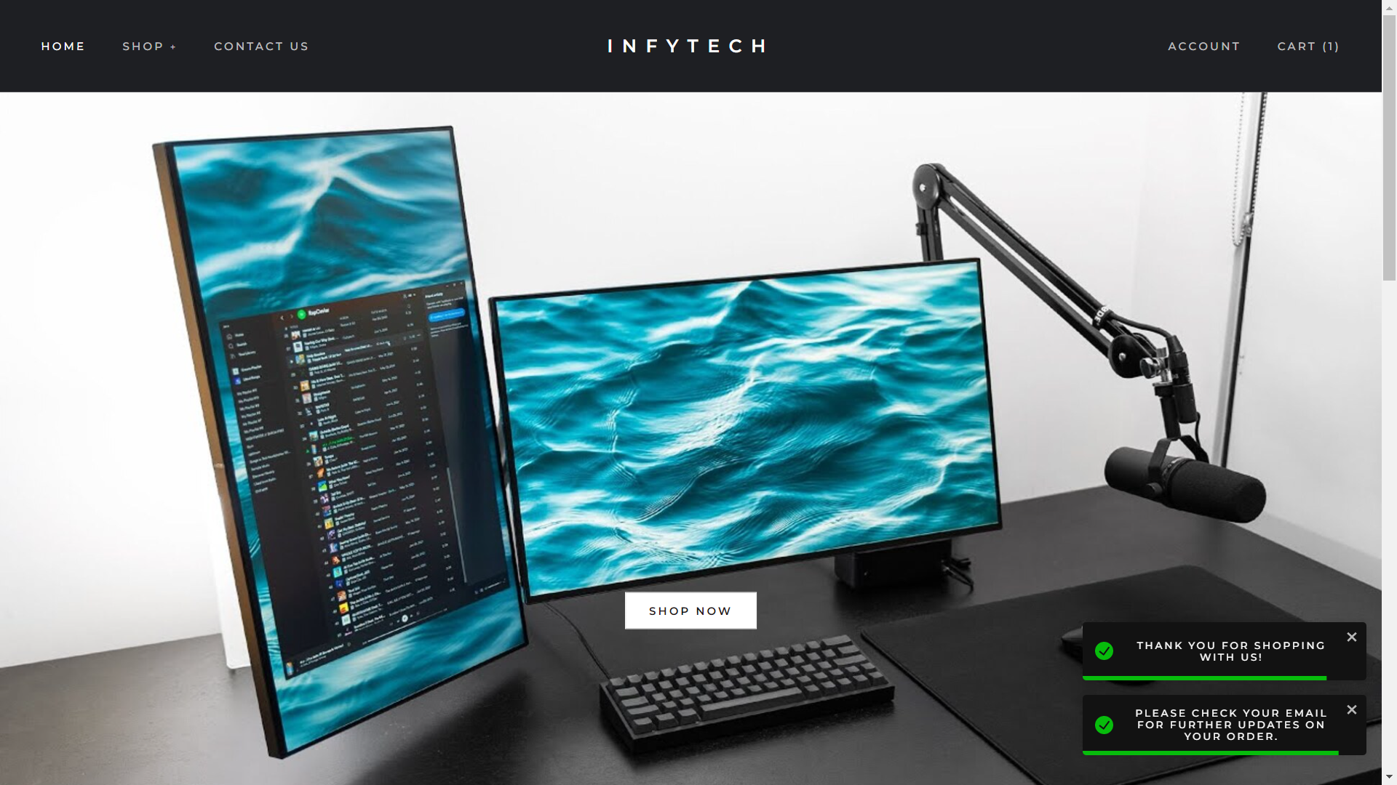
On Order Success

Slide 41
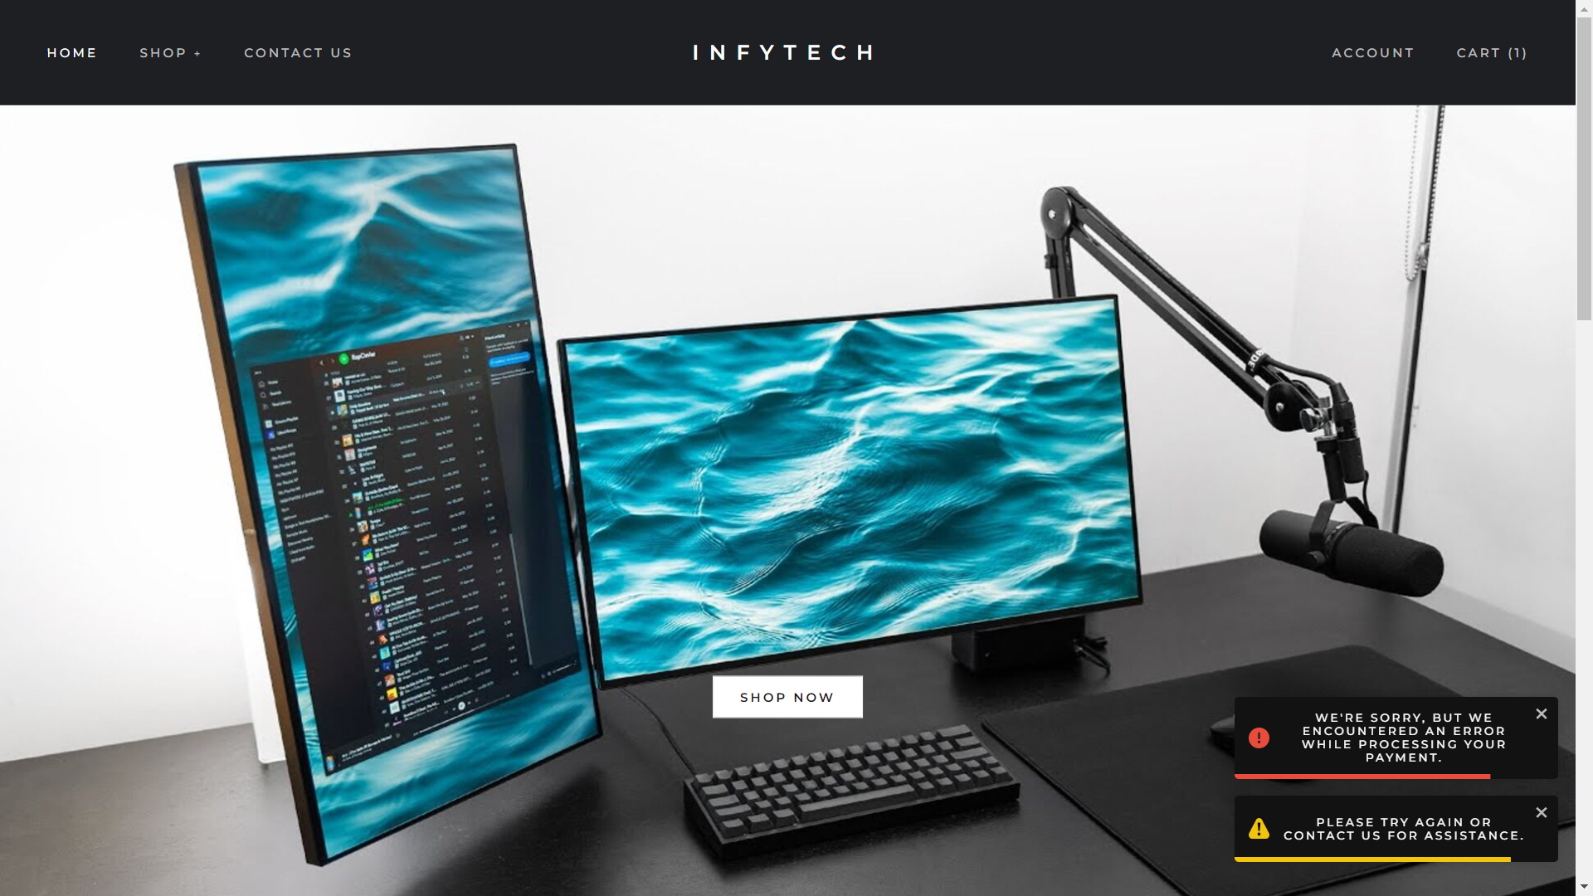
On Order Failure

Slide 42
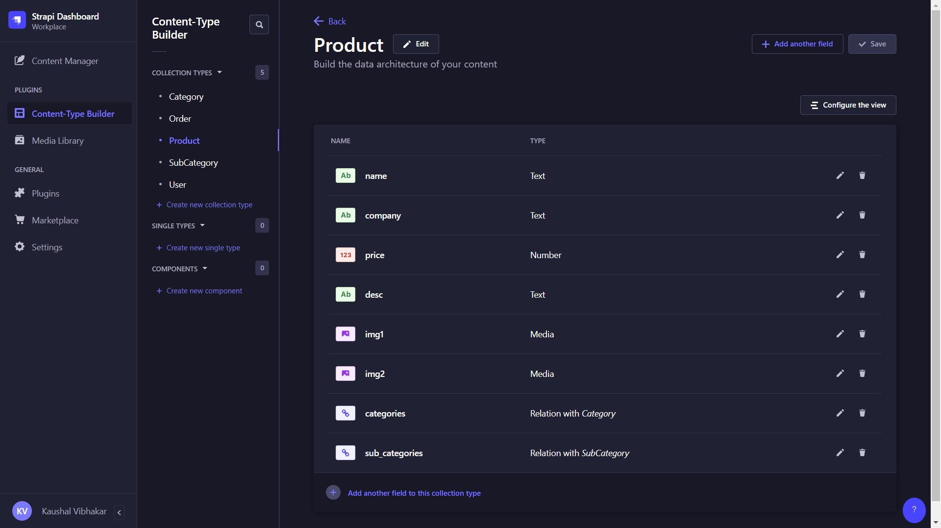
Strapi Content Type Builder

Slide 43
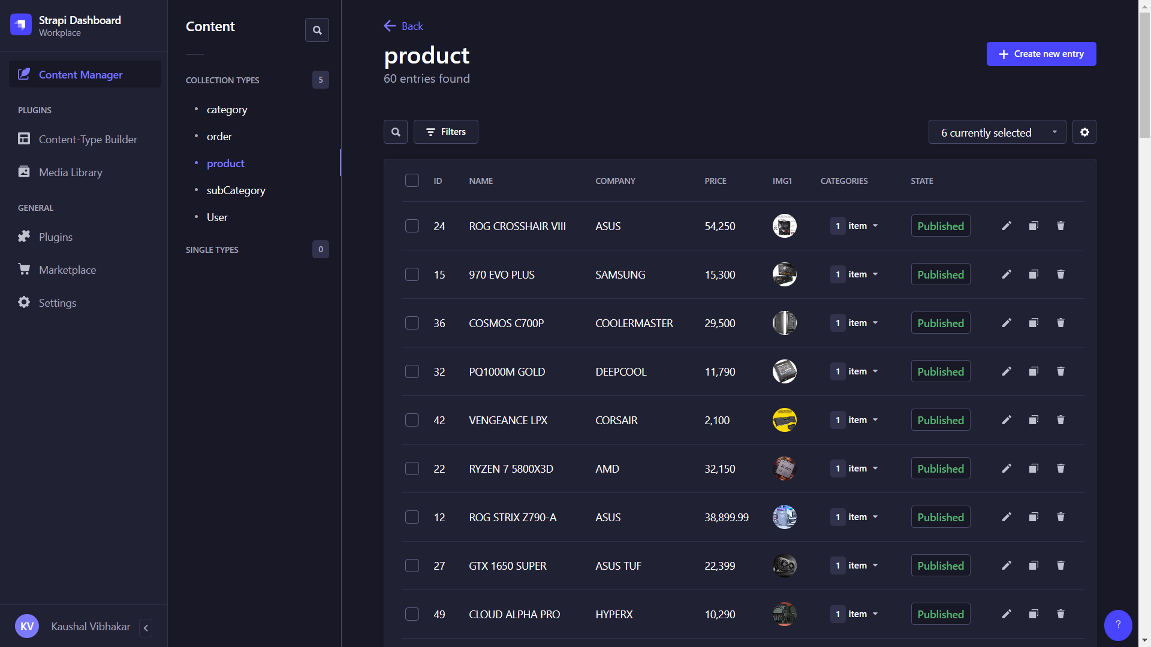
Strapi Content Manager

Slide 44
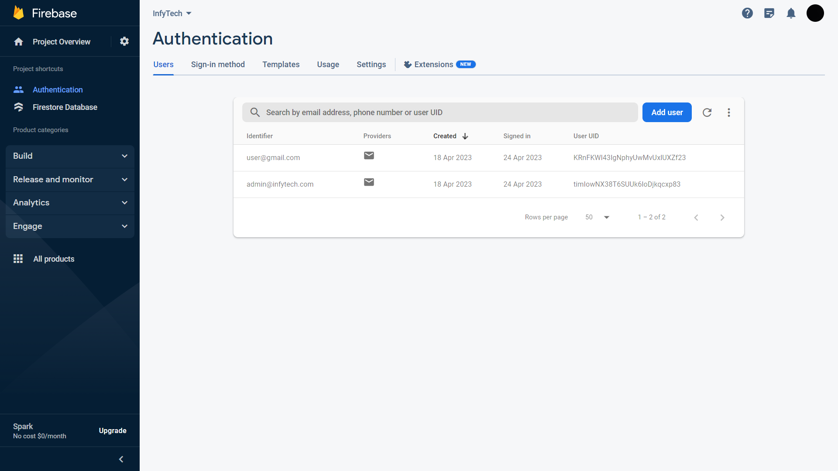
Firebase Authentication

Slide 45
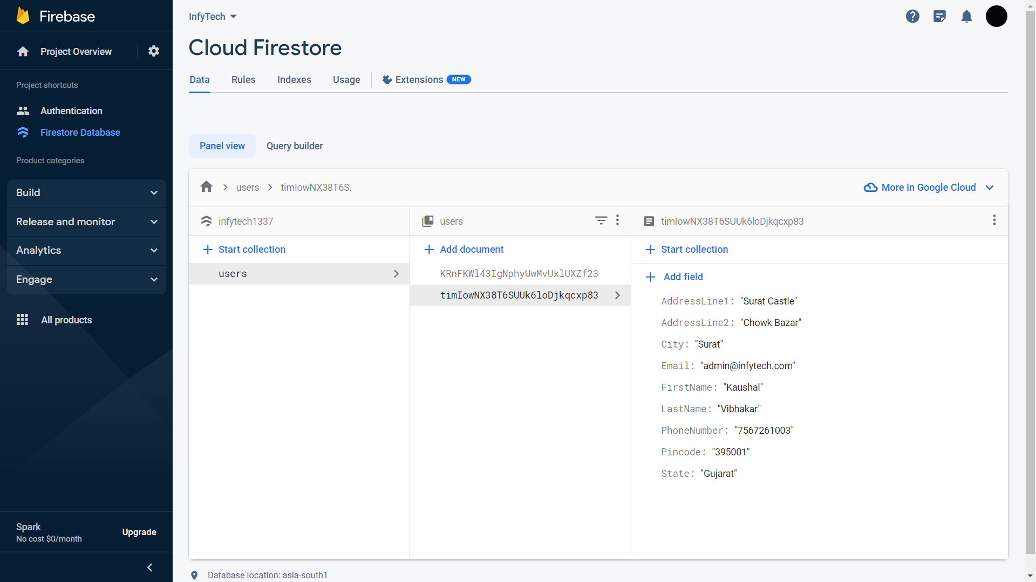
Firestore Database

Slide 46
About InfyTech
If you are someone who enjoys playing video games, then there are a lot of options these days. Not only do you have various consoles, PC, but even mobile phones too. However, among these the most popular and arguably the best one is the PC. If you are after the best gaming experience, it is a gaming PC that you should opt for. When you are planning on purchasing a gaming PC, or any PC in general, you have lots of options these days.

Slide 47
About InfyTech
You can either get one offline, i.e. from local stores, or online. There are various pros and cons for both of these options. However, as the world becomes more familiar with the Internet, the more popular online options get. In India, there are various reputed online stores when it comes to purchasing computer parts such as peripherals, hardware components, accessories, etc. Due to this, it gets confusing to choose one. Among all them, one of the options is InfyTech. We are an upcoming computer accessories store and eSports tournaments organizer in India.

Slide 48
Thank you

